Slide 1

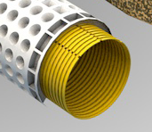


New Drain Pipe-Envelope Concept for Subsurface Drainage Systems in Irrigated Agriculture
İdris Bahçeci, Abdullah Suat Nacar, Lui Topalhasan, Ali Fuat Tari, Henk Ritzema
Harran University, GAP Agricultural Research Institute, Hydroluis, Wageningen University & Research

Slide 2
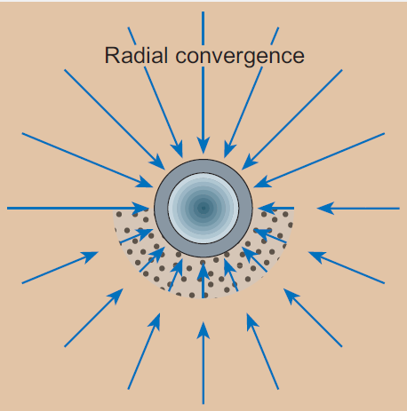
Envelope has 3 functions:
Filter function: to prevent soil particles entering the drain pipe
Hydraulic function: to reduce entrance resistance
Bedding function: to provide support /to protect the drain pipe
Ritzema et al., 2006

Slide 3
Three types of envelope materials
Organic: peat, coconut fibres, straw, etc.
Mineral: granular: gravel, coarse sand, etc.
Synthetic: granular (e.g. polystyrene) or fibrous (nylon, polypropylene)
Cavelaars et al., 2006

Slide 4
Soils in need of an envelope
Soils in need of an envelope:
High percentage in silt and
fine sand and low clay content
Cavelaars et al., 2006

Slide 5
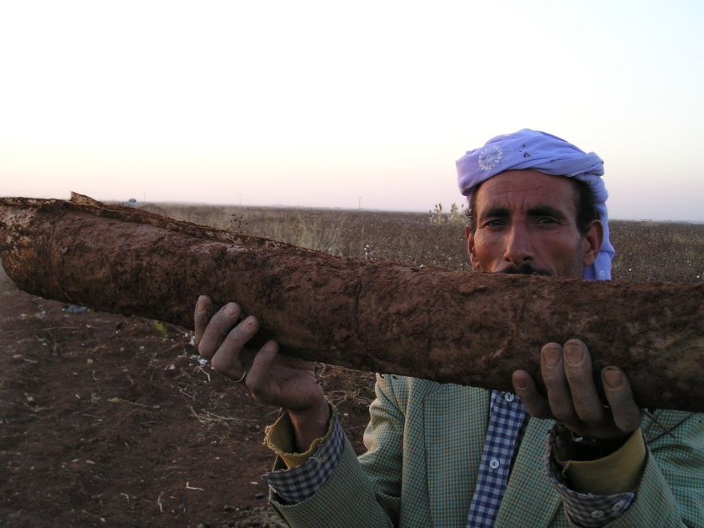
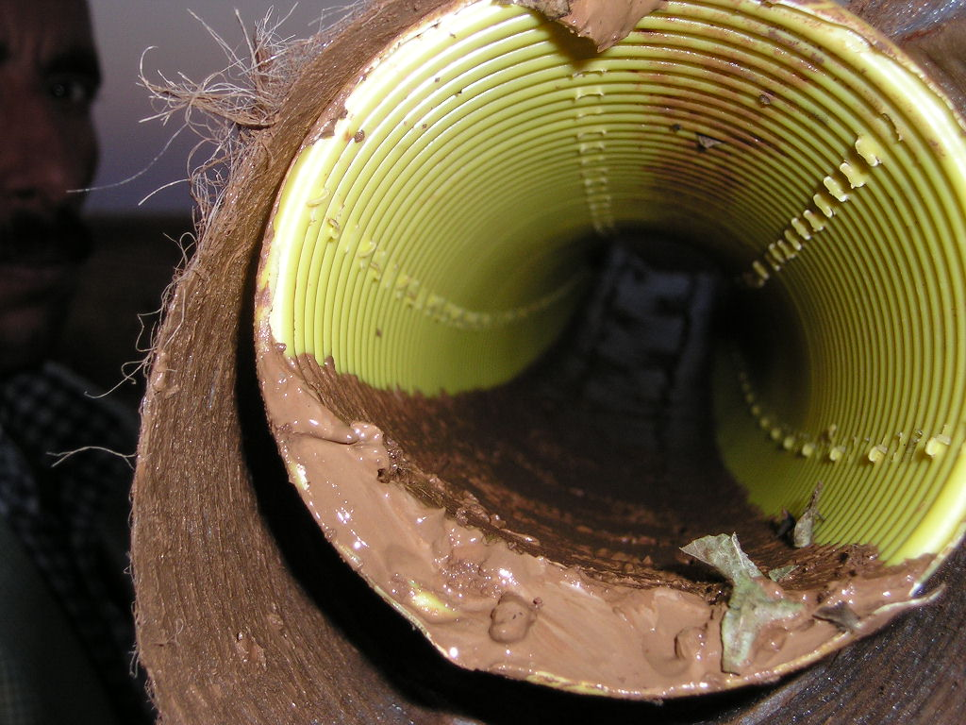
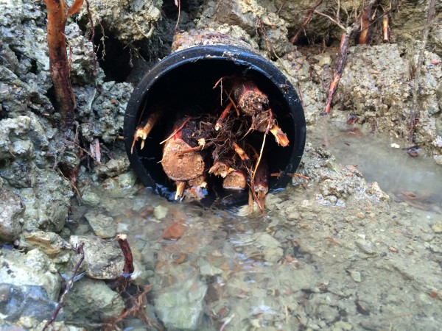
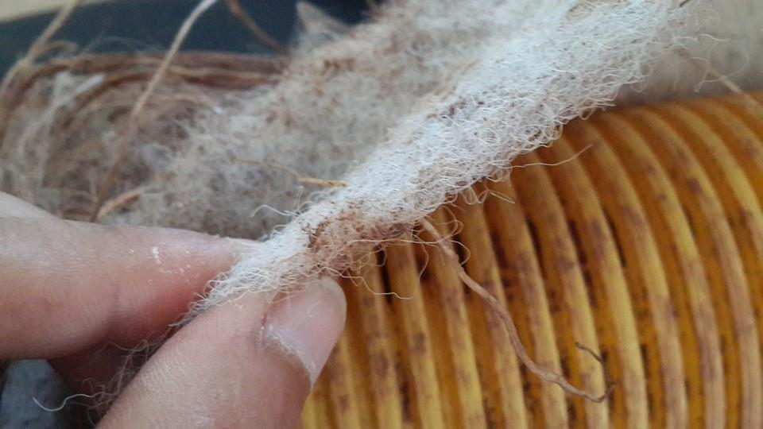
Common problems in irrigated agriculture
Clogging
Sedimentation in unstable soil
Root growth
inside pipe

Slide 6
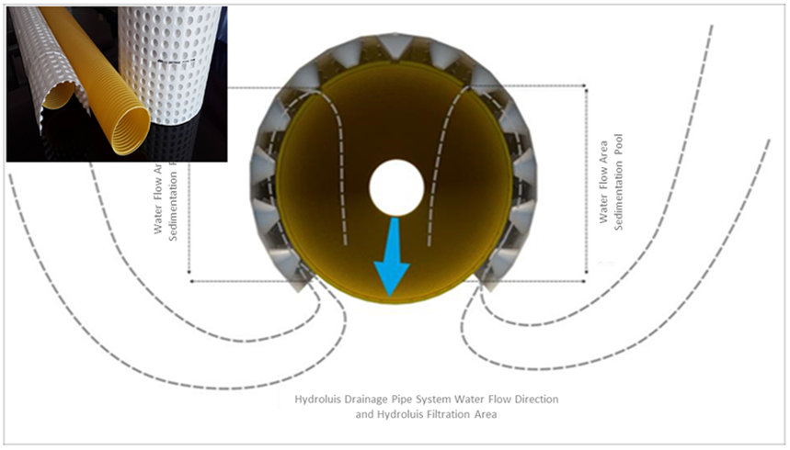
Hydroluis Drain pipe – envelope concept

Slide 7
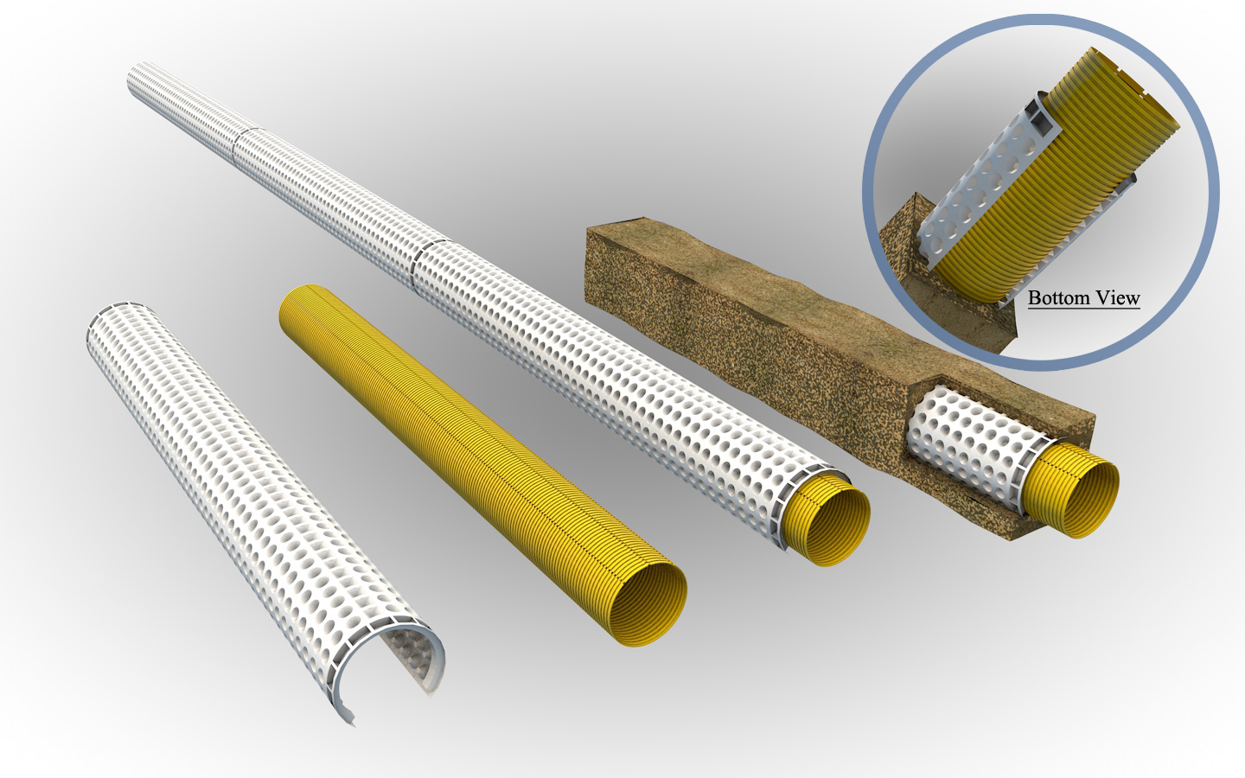
Hydroluis – 2 components: inner and outer pipe
Outer pipe:
Unperforated,
covering 2/3
of inner pipe
Inner pipe:
two rows of
perforations on top

Slide 8
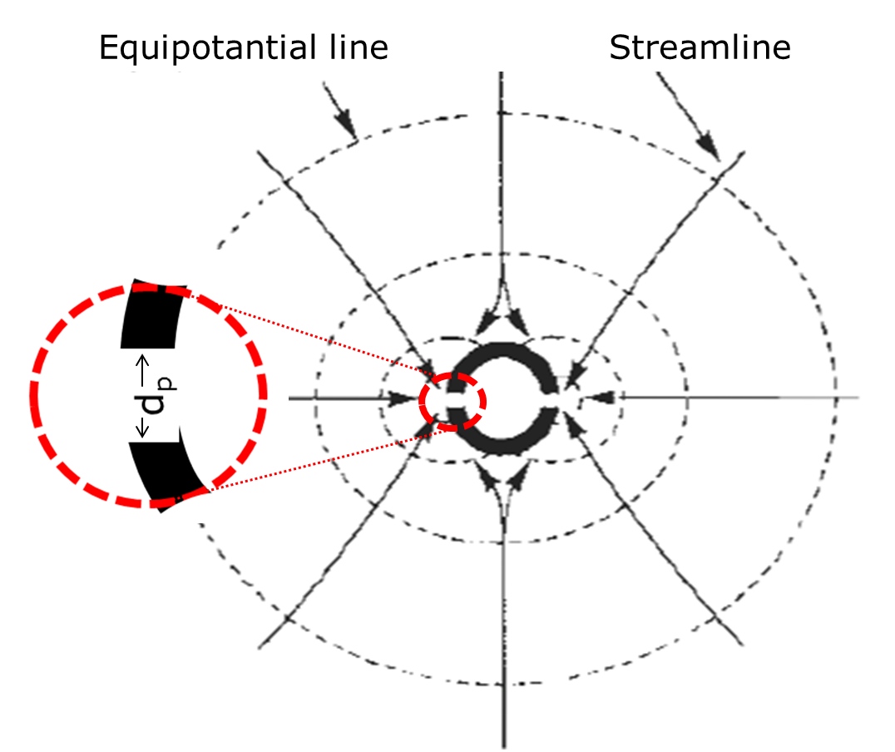
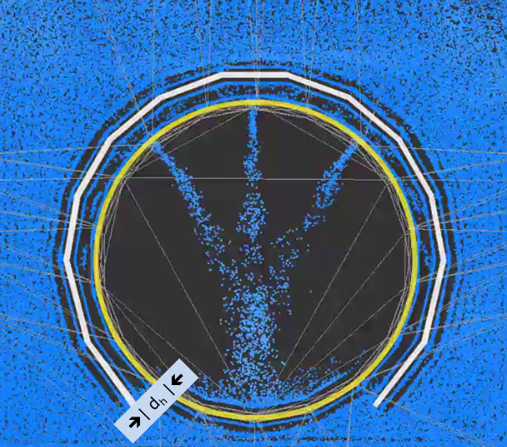
Hydroluis – Principle 1: to avoid sedimentation
Perforated pipe with contracting stream lines Hydroluis with inner and outer pipe
inflow opening d_{h} >> d_{p} ➔ inflow velocity ↓ ➔ soil particle movement ↓

Slide 9
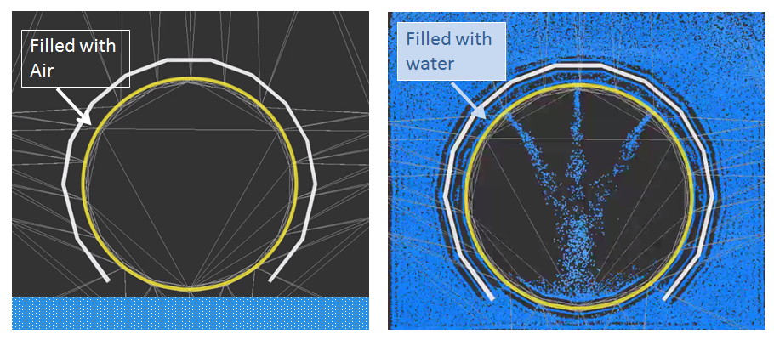
Hydroluis – Principle 2: to avoid root growth
Groundwater table below drain pipe
Groundwater table above drain pipe

Slide 10
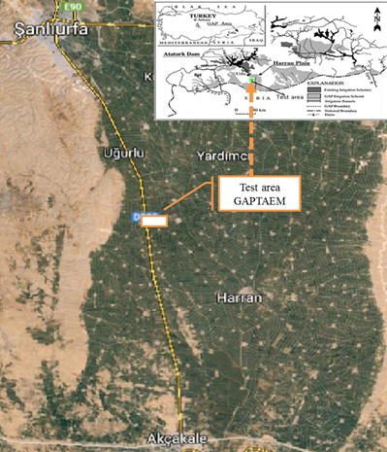
Field study: GAPTAEM research station (50 ha) near Harran, Turkey
Drain depth: 1.50 m
Drain spacing: 25 – 60 m
Drain length: 200 – 250 m
Drain slope: 0.1%
Four combinations were tested:
Sand-gravel envelope
Pre-wrapped geotextile
Hydroluis® pipe-envelope combination
No envelope material (control)

Slide 11
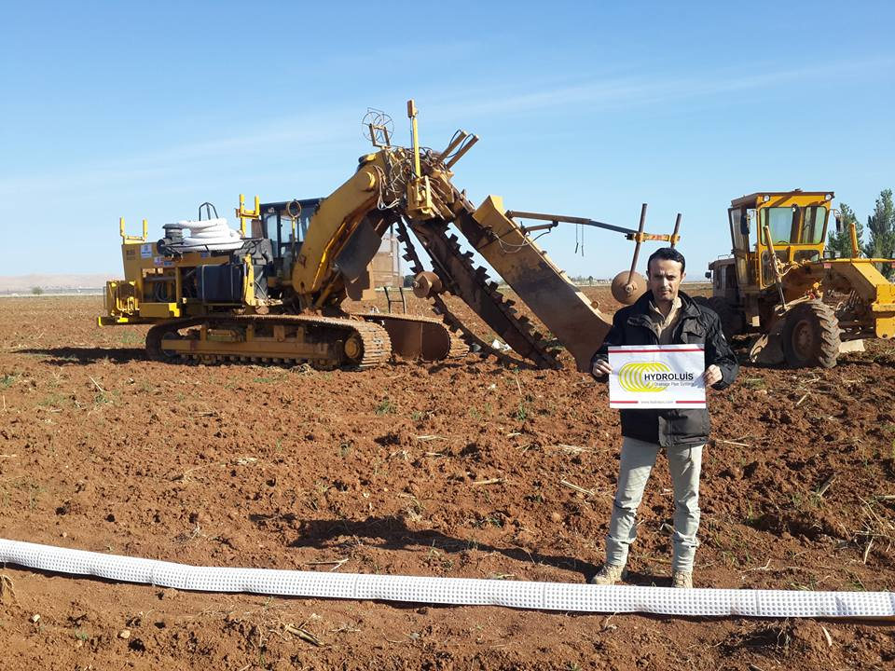
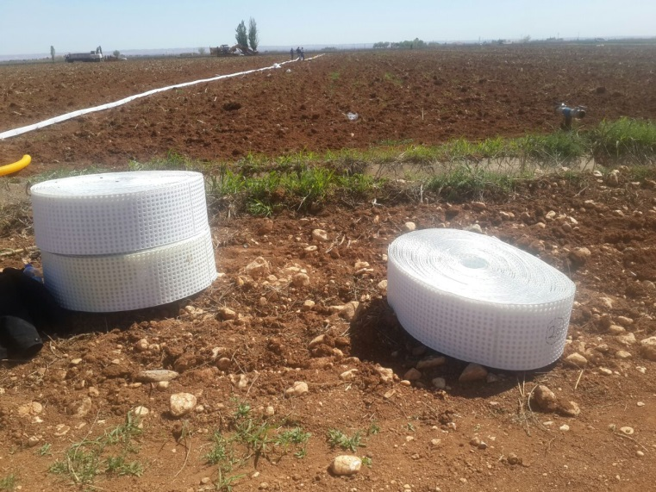
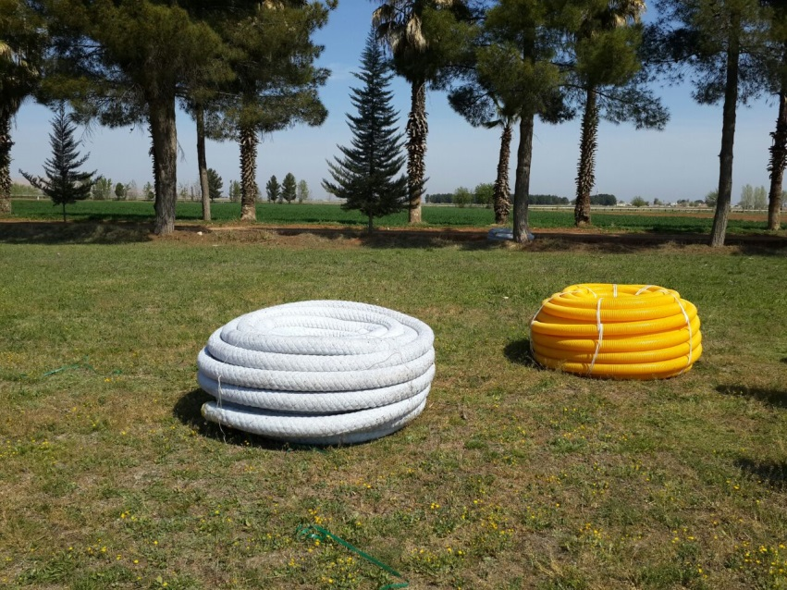
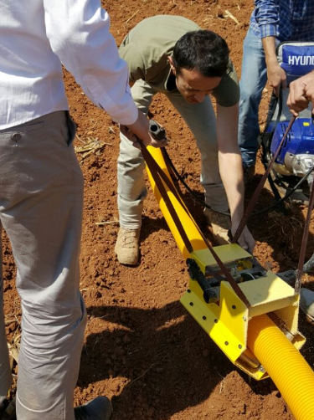
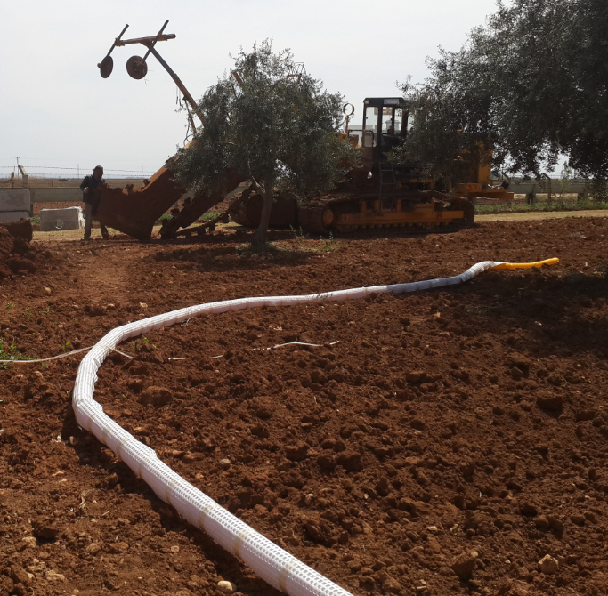
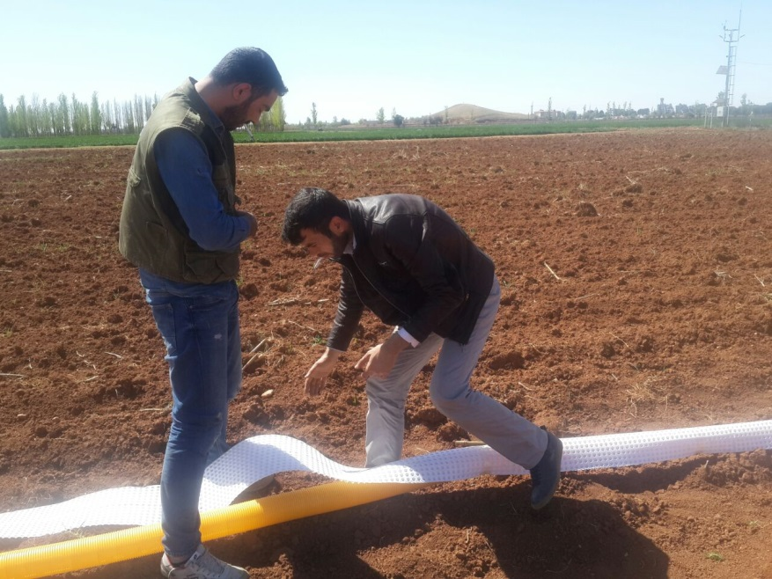
Installation

Slide 12
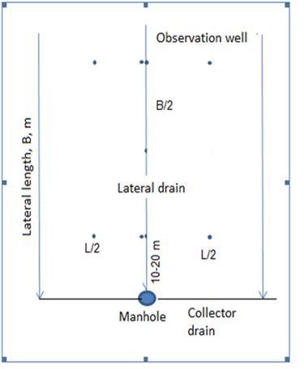
Monitoring programme
Each drain & envelope combination: 3 field/lateral drains connected to manhole
Daily observations after irrigation:
Groundwater observations: inside & outside drain pipe and midway between drains
pH, EC and silt load of drain discharge in manhole
End of season
By video: Root growth
By video: Sedimentation
Excavation of pipes

Slide 13
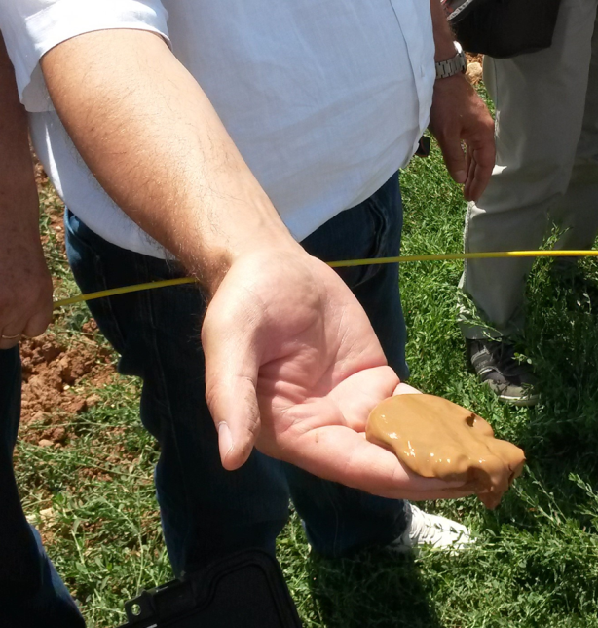
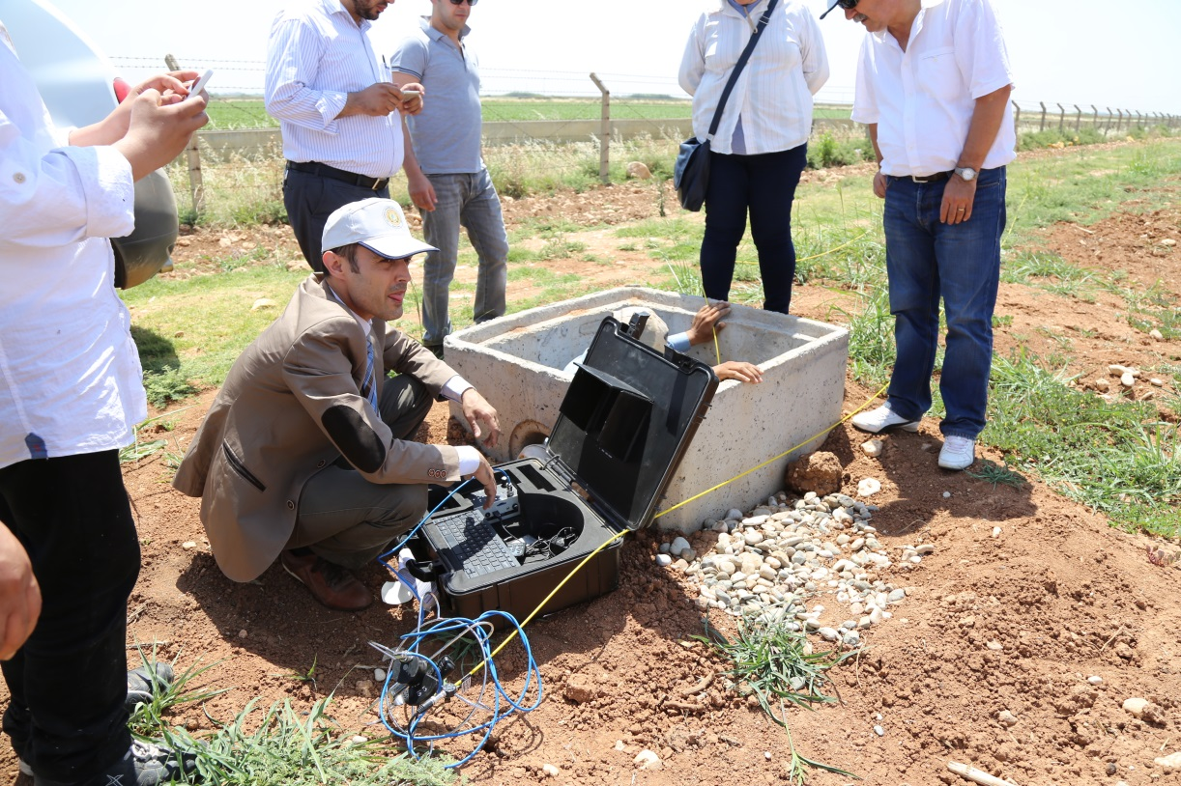
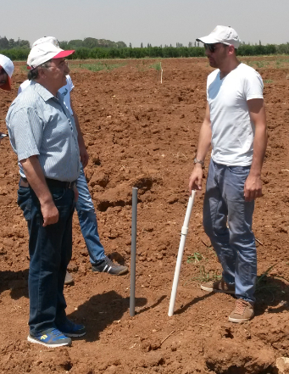
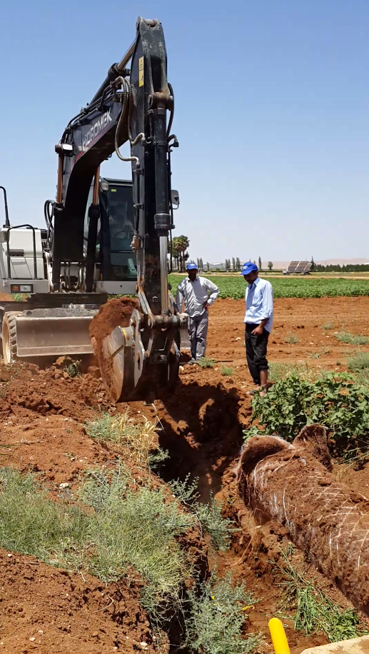
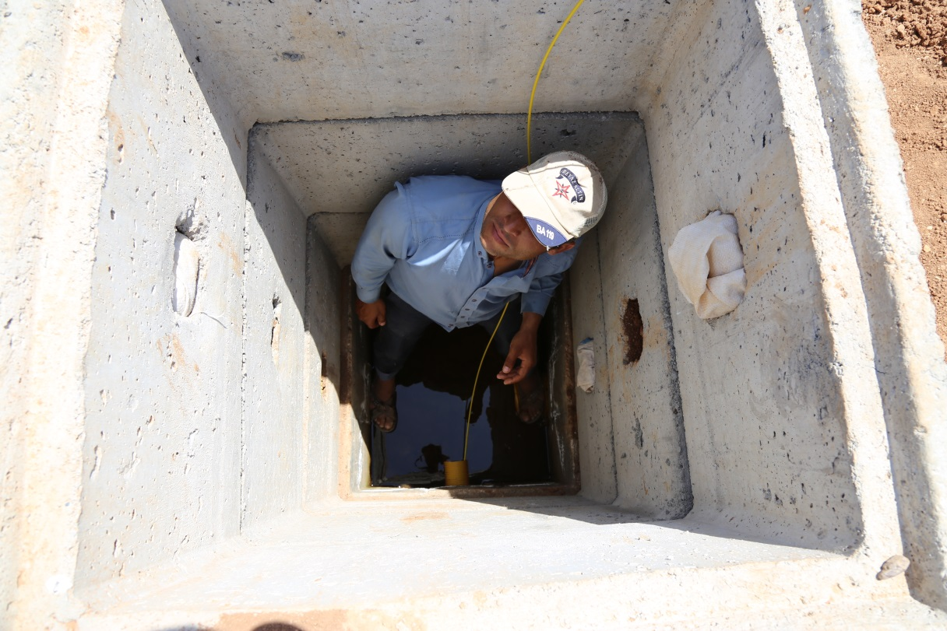
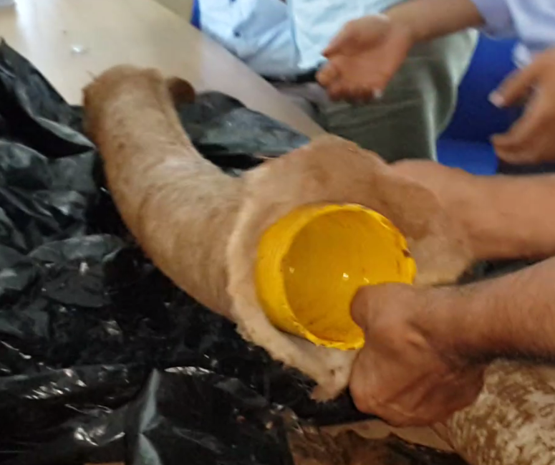
Monitoring

Slide 14
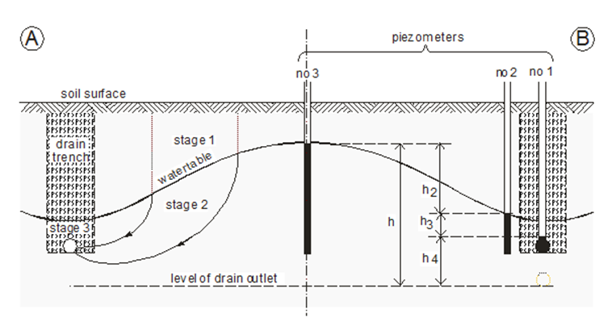
Principles of testing
h₃/(h₂+h₃) | Entrance resistance | Drain performance
< 0.2-0.3 | normal | good
0.3 – 0.6 | high | moderate to poor
> 0.6 | excessive | very poor
Cavelaars et al., 2006

Slide 15
Drain performance in 2015
Envelope pipe combination | h₃/(h₂+h₃) (-) | Drain performance | pH | EC (dS m⁻¹) | Silt (g m⁻³)
Gravel | 0.25 | Good | 7.2 | 0.96 | 26
Geotextile | 0.38 | Moderate to poor | 7.5 | 0.99 | 35
Hydroluis®) | 0.28 | Good | 7.0 | 0.97 | 34
Control | - | - | 7.2 | 1.03 | 46

Slide 16
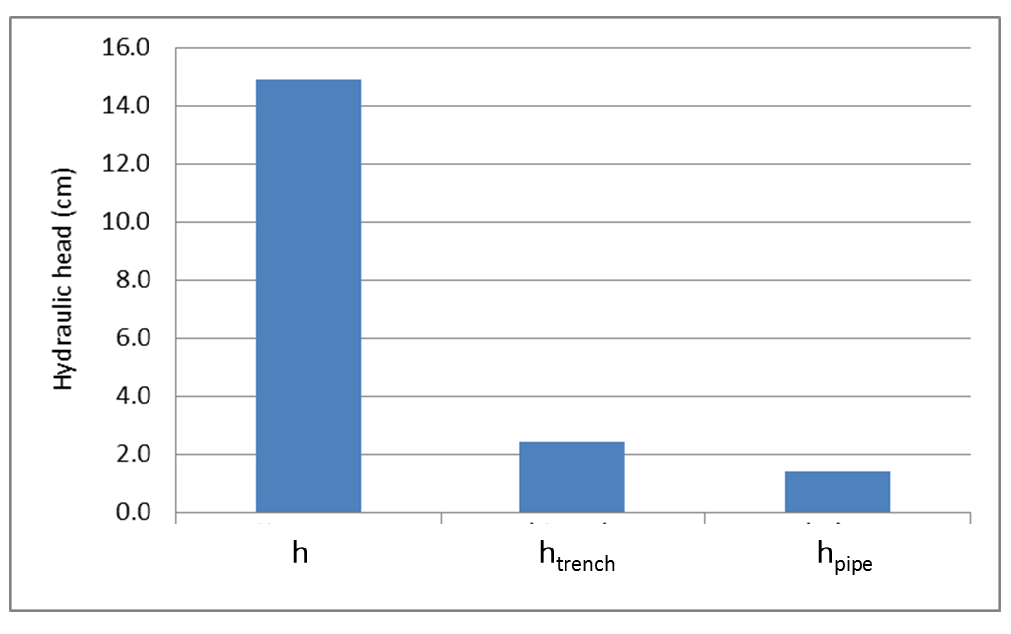
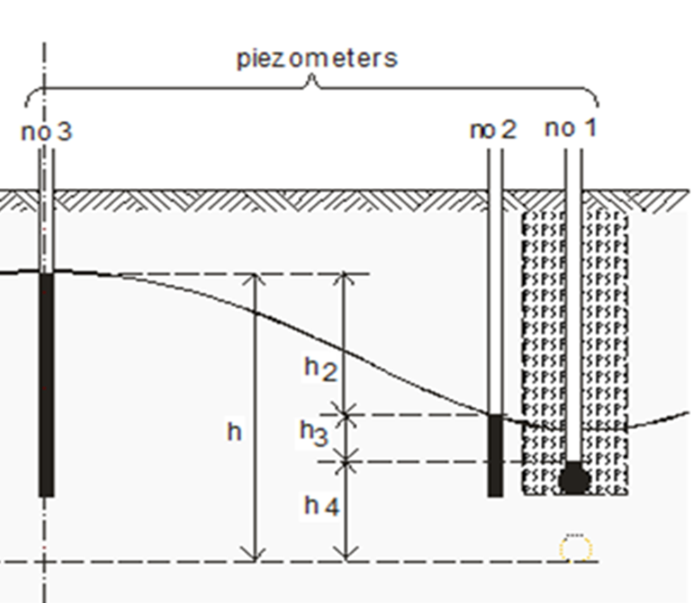
Hydraulic head in Hydroluis system in 2016
h h_{trench} = h-h₂ h_{pipe} = h-h₂-h₃

Slide 17
Classification of Entrance resistance & drain performance in 2015 & 20126
Pipe -Envelope combination | 2015 |  |  | 2016
 | h₃/(h₂+h₃) | Entrance resistance | Drain performance | h₃/(h₂+h₃) | Entrance resistance | Drain performance
Gravel | 0.25 | normal | good | 0.38 | normal | moderate
Geotextile | 0.38 | normal | moderate | 0.61 | high | very poor
Hydroluis® | 0.28 | normal | good | 0.07 | normal | good
Control | - |  | - | 0.49 | high | moderate to poor
No. | Solid matter | EC
 | (%) | (dS/m)
Hydroluis | 0.07 | 0.79
Geotextile | 0.07 | 1.00

Slide 18
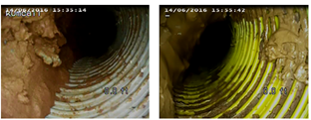
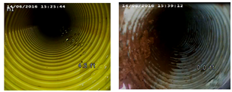
Visual inspection (14 June, 2016): sedimentation
Gravel
Geotextile
Note: Vertical orientation is not correct because of moving camera
Hydroluis
Control

Slide 19
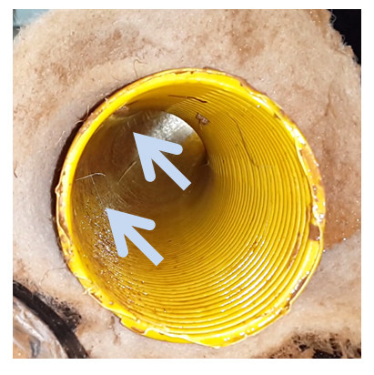
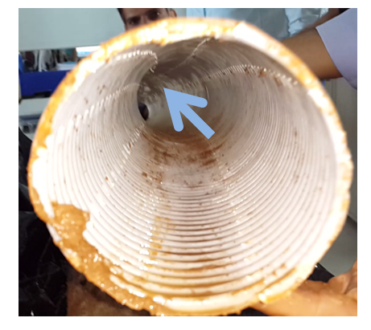
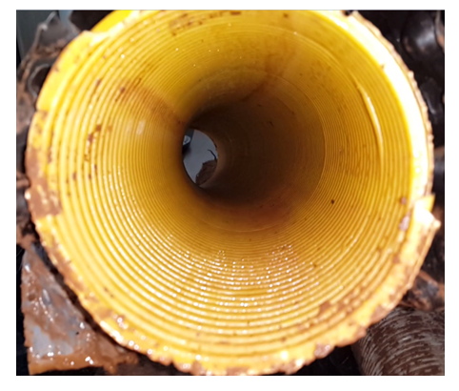
Visual inspection (14 June, 2016): root growth
Geotextile
Control
Hydroluis

Slide 20
Conclusions
Results of two-year monitoring programme:
Entrance resistance and drain performance:
Hydroluis: normal entrance resistance & good drain performance
Gravel: normal entrance resistance & moderate/good drain performance
Hydroluis & gravel better than geotextile and control
Geotextile: performance decrease over time ➔ clogging
2) Root growth:
Hydroluis no signs of root growth
3) Hydroluis: good mechanical support against deformation (egg-box profile)
4) Production cost comparable with pre-wrapped synthetic envelope*
* Personal communication, PipeLife

Slide 21
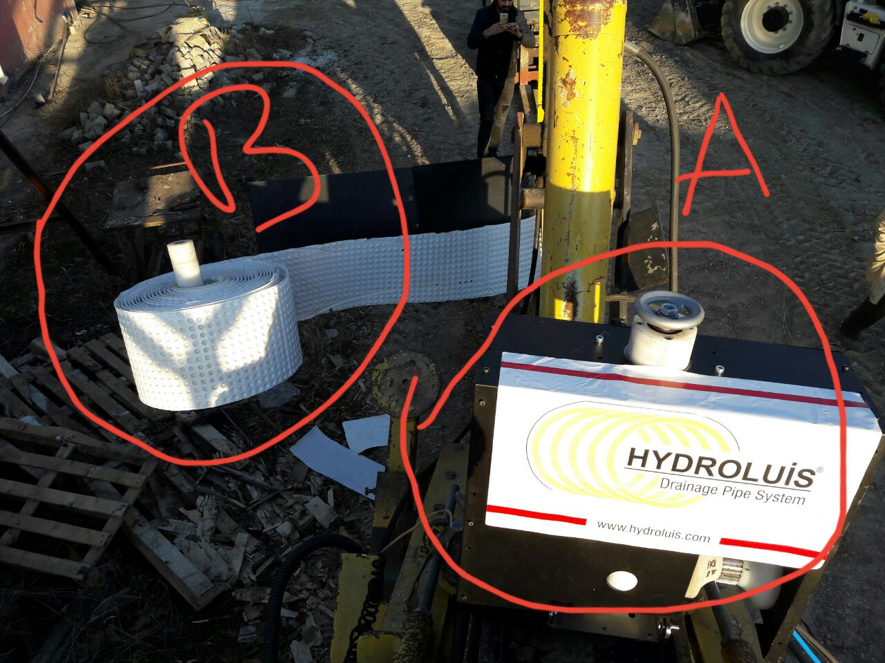
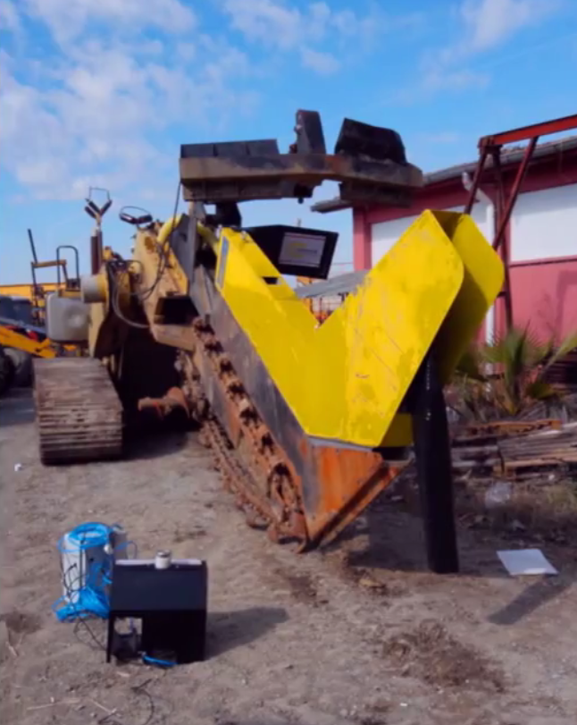
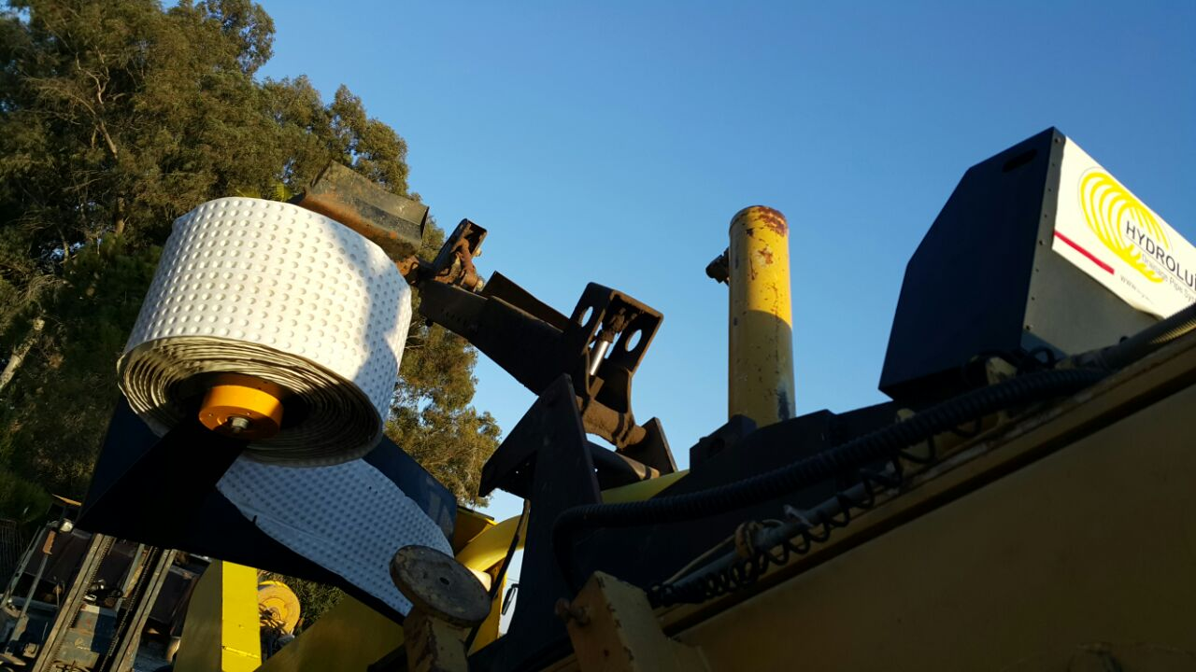
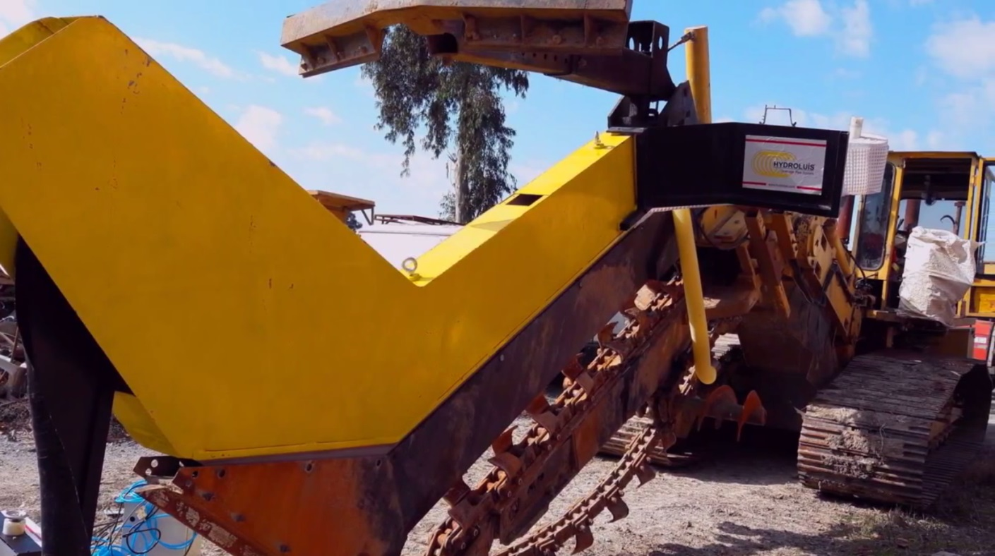
Latest developments

Slide 22

New Drain Pipe-Envelope Concept for Subsurface Drainage Systems in Irrigated Agriculture
We are looking for more pilots?
bahceci@harran.edu.tr
abdullahsuat.nacar@gthb.gov.tr
hydroluis.drainage@gmail.com
henk.ritzema@wur.nl

